Slide 1
Presentation: Simplified Implementation of NOMA in 5G Networks

Slide 2
Title: Simplified Implementation of NOMA in 5G Networks Subtitle: Demonstrating Efficiency in Bandwidth Management Presented by: hasan alnaim 222434746 Muhannad Naif 222415211 Ali Alyami 222438546

Slide 3
Introduction
What is the Project About?
In this project, we developed a simplified implementation of Non-Orthogonal Multiple Access (NOMA) in 5G networks to demonstrate its efficiency in bandwidth management.
Why is this Important?
With the increasing number of devices connecting to networks, bandwidth management has become critical.
NOMA enables simultaneous data transmission for multiple users, improving network efficiency compared to traditional methods.

Slide 4
Objectives
The main objectives we focused on were:
Implementing a simplified version of NOMA to handle multiple users efficiently.
Comparing its performance with Orthogonal Multiple Access (OMA).
Testing its robustness under noisy conditions to simulate real-world scenarios.

Slide 5


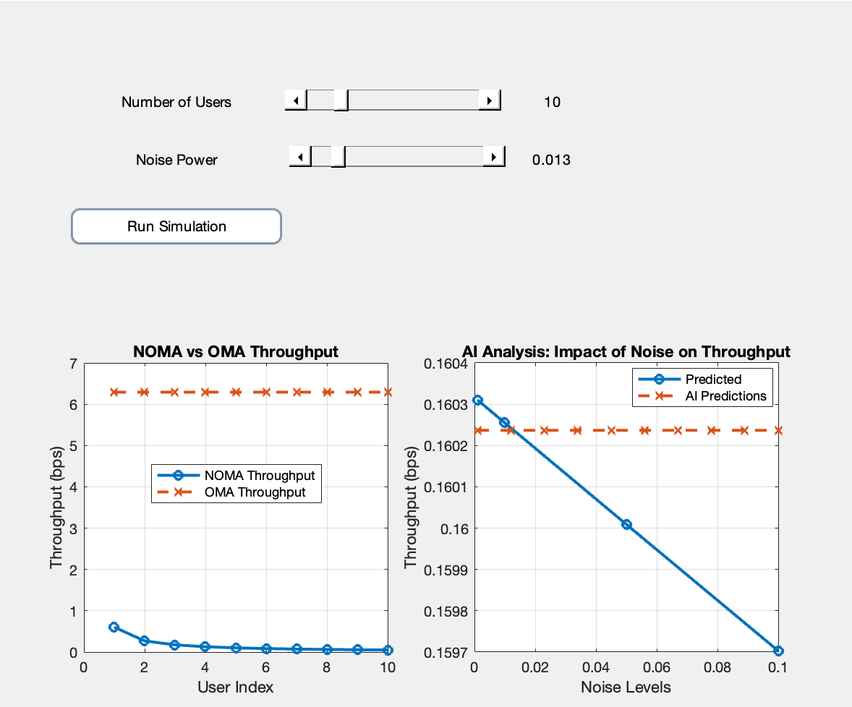

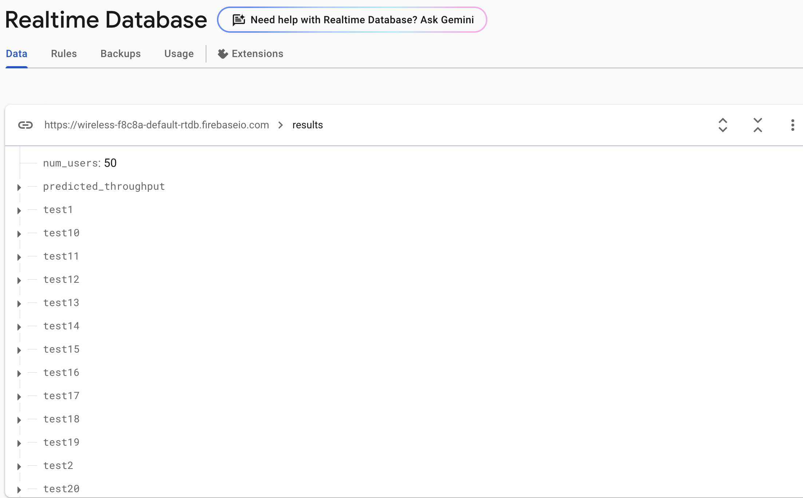
Tools and Technologies
Software:
We used MATLAB to design and simulate the NOMA and OMA models.
Python NOMA libraries were employed for additional analysis.
Cloud Platforms:
Firebase was used to store the simulation results and visualize the data.

Slide 6
Implementation Overview
Step 1: Study NOMA basics:
We started by understanding key concepts like power domain separation and user pairing.
Step 2: Create simulations:
Using MATLAB, we simulated data transmission scenarios to compare NOMA and OMA performance.
Step 3: Analyze efficiency:
We measured throughput and demonstrated how NOMA outperforms OMA in terms of bandwidth efficiency.
Step 4: Store results:
We uploaded the simulation data to Firebase and generated visual reports for better insights.
Step 5 (Bonus): Test robustness:
We added noise to the simulations to evaluate NOMA's performance under challenging conditions.

Slide 7
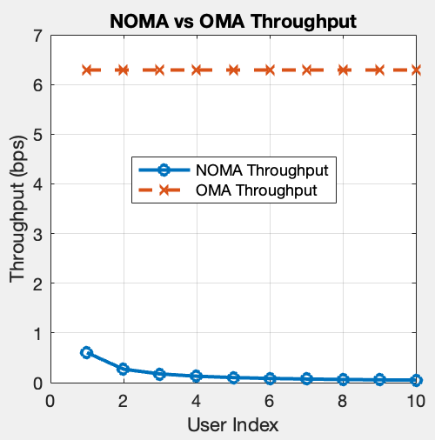
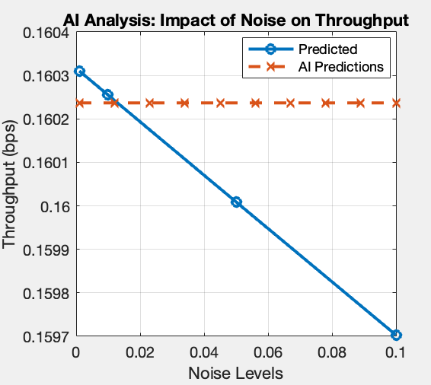
Results (Visualization)
NOMA vs. OMA Efficiency:
We generated a graph comparing the throughput of NOMA and OMA using MATLAB. This graph highlights the efficiency gains of NOMA.
Noise Impact Analysis:
Another graph shows the impact of added noise on NOMA's performance, which we simulated to test robustness.

Slide 8
Role of Artificial Intelligence in the Project
We utilized Machine Learning algorithms to analyze data and predict system throughput based on parameters such as the number of users and noise levels."
"Deep Learning was not used as the project did not require the complexity of neural networks. Instead, we relied on simple yet effective algorithms such as Gaussian Process Regression (GPR)."

Slide 9
Dataset Used for Model Training
Content:
"The dataset was generated through MATLAB simulations."
"The dataset includes the following parameters:
Number of users: 2 - 50.
Noise levels: 0.001 to 0.1.
Total power: 10 watts.
Throughput results for both NOMA and OMA."
"This dataset was used to train the model to predict throughput

Slide 10
Steps for AI Model Training
Data Collection:"We simulated throughput data under different noise levels and user counts using MATLAB."
2. Data Preparation:"Formatted the data to be suitable for Machine Learning training."
3. Model Training:"Used Gaussian Process Regression (GPR) to train the model with Python libraries."
4. Prediction:"Tested the model with new, unseen data to predict throughput."
5. Validation:"Compared AI predictions with actual results calculated through MATLAB

Slide 11
Comparison of AI Predictions and Actual Results
The predicted results from AI were plotted alongside actual simulation results."Graph: Include the graph showing the two lines (Predicted vs. AI Predictions) to illustrate the accuracy of AI predictions.
Outcome: "The AI model provided highly accurate predictions, demonstrating the reliability of the approach
Question: "How can we verify the model's accuracy?
We compared the AI predictions with actual results and calculated the Mean Absolute Error (MAE).

Slide 12
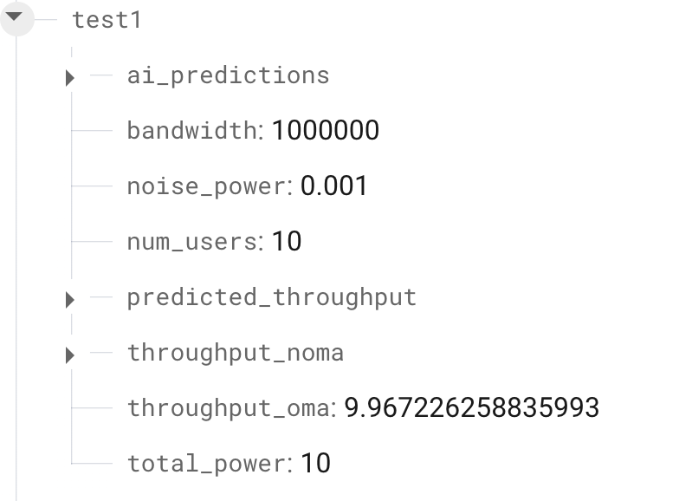
Firebase dashboard
What We Stored in Firebase:
Number of users (Number of Users).
Noise power (Noise Power).
Throughput results for NOMA and OMA.
Predictions generated by the AI model (AI Predictions).

Slide 13
Code Implementation Highlights
We developed an interactive UI using MATLAB, which allows users to adjust parameters like the number of users and noise power.
The code includes real-time visualization of throughput comparisons.
We integrated AI-driven predictions using Gaussian Process Regression to forecast system performance under varying conditions.
The results are stored in Firebase for easy access and sharing.

Slide 14
Conclusion
Through this project, we demonstrated that NOMA provides superior efficiency compared to OMA in managing bandwidth.
Robustness tests revealed how NOMA performs under noisy conditions, emphasizing its practicality in real-world scenarios.

Slide 15
Thank You

